Slide 1
BioBESTicide, the eco-friendly and sustainable solution for vineyards diseases
1st BioBESTicide webinar
December 2022

Slide 2
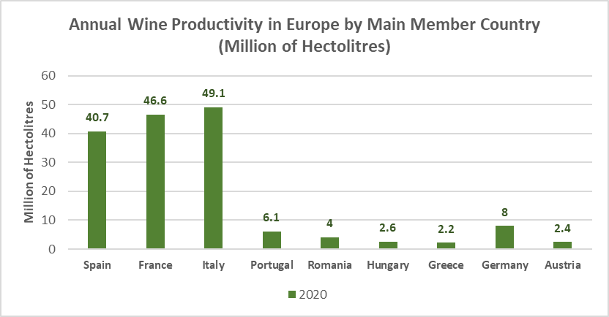
Wine production
The size of the European wine market exceeded €136 billions in 2020
Produced 165 million hectolitres in 2020
Wine is the largest EU agri-food sector in terms of exports (7.6% of exported in 2020)
Annual wine productivity over the European scenario as reported by DG Agri.
https://ec.europa.eu
Notes:
The production of wine for Europe is not just one of the main agroindustry in the food sector, also represents a cultural part and identity of the continent
This table shows the main countries related to the wine production, we can observe that Italy is the biggest one, closely followed by France and Spain
The size of the European wine market exceeds 136 billions of euros and produced about 165 million of hectoliters in 2020
Wine production is so important that in the same year, it represented 7.6 of the total food exportations of the EU

Slide 3
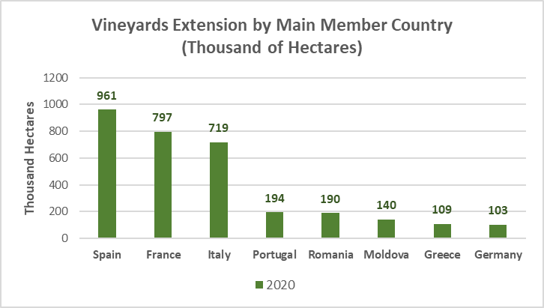
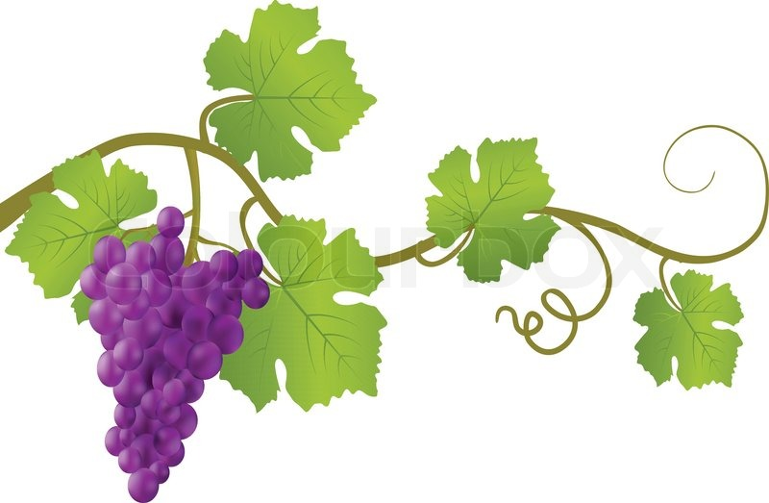
Wine production
Global extension of vineyards 7.3 mha while Europe accounted for 3.3 mha in 2020 (45%)
Italy, Spain and France are the major representants over 74% of the total area
Over 20% of vineyards were affected by GTDs in 2015
Infections incidence up to 19% in Italy, over 13% in France and 10% in Spain
Economic loss of about €1b
Sodium arsenate banned in EU in 2001
Vineyards extension over the European scenario as reported by the International Organisation of Vine and Wine (OIV).
International Organisation of Vine and Wine (OIV).
Notes:
But how spread is this problematic in Europe??
The total area of vineyards in the world reach to 7.3 million of hectares, and just in Europe 3.3 million of hectares are dedicated for wine production, reaching up to 45% of the worldwide production
Being Spain, France and Italy, they represents the 74% of all the vineyards areas in Europe.
From these 3.3 million of hectares, around 20% were reported to being affected by GTDs in 2015 ,
Among all these vineyards affected, Italy has suffered an incidence of 19% of GTD in its vineyards….
It is estimated that GTDs can be related to up to 1 billion euros loss
Sodium arsenate was a very effective solution for GTDs control, but was highly toxic for human health and the environment,
The lack of an efficient treatment for the GTDs, favoured the dissemination of this problematic
The need of a sustainable, safe and effective treatment was encouraged

Slide 4
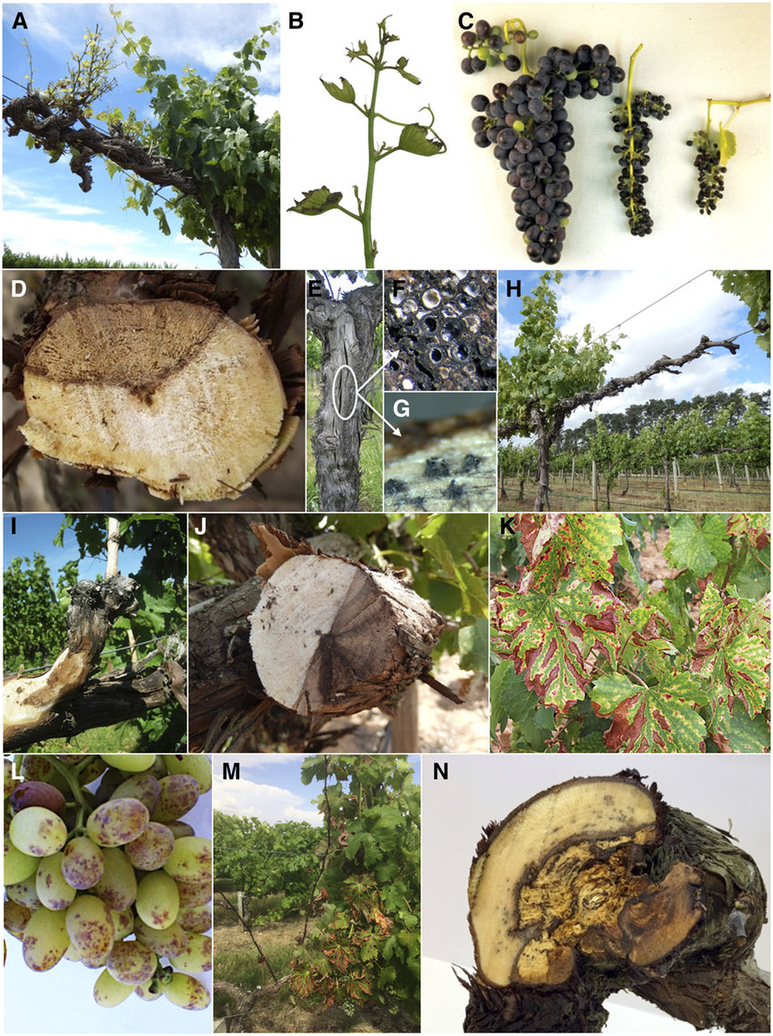
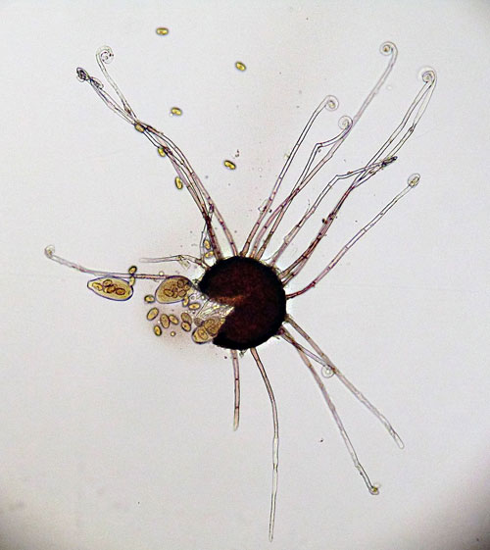
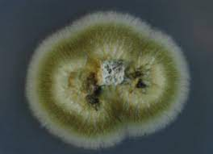
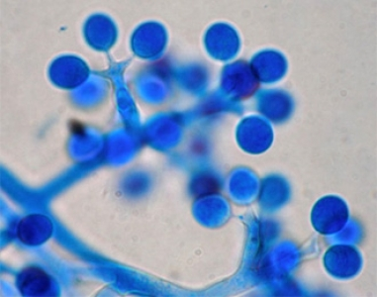
Problematic: Grape trunk diseases
The Grapevine Trunk Diseases (GTDs) are among the major threats for the economic stability of the winery sector worldwide
Main biotic factor reducing vines’ yields
Increasing crop management costs
Wine quality reduction
Phaeomoniella chlamydospora
Erysiphe necator
Plasmopara viticola
Gramaje et al., (2018)
Notes:
Nevertheless, there is a problematic hindering the vineyards and thus the wine production, the Grapevine Trunk Diseases or GTDs,
These vineyards affection, are one of the main threats for the economic stability not only of the wine sector but other grape related products like Cognac all around the world
The GTDs can affect all the parts of the plant and up to cause necrosis
GTDs are mainly related to these plant pathogens showed among others
The infection of the vineyards by these agents can reduce the overall production yield, increase the management cost of the vineyards and in general reduce the quality of the final product

Slide 5
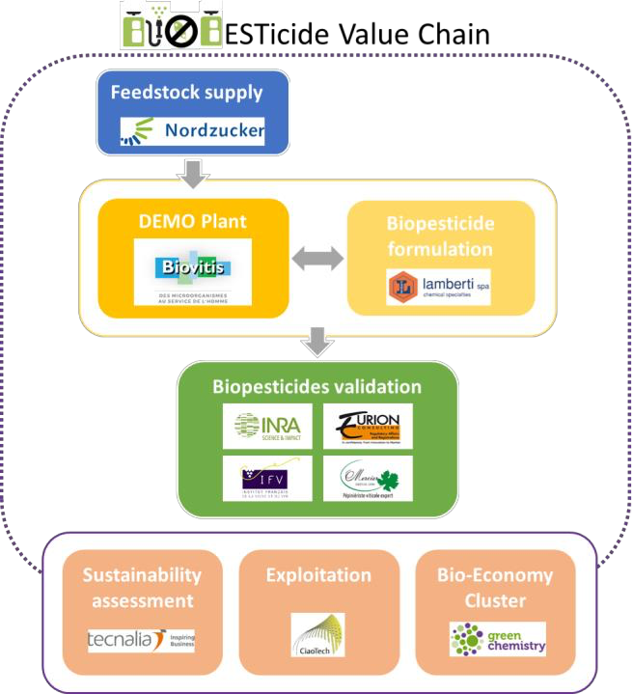
BioBESTicide: Partnerships
Partners related
Notes:
For the creation of the BioBESTicide solution, a multidisciplinary group was required, this supported with more than 8 years of research
10 partners collaborate in different aspects of the BioBESTicide project,
Since suppliers (the use of by-products is sustainable),
Pythium oligandrum production and oospores formulations for assuring the production yield and the correct integration of the oospores to the fields
Also, different partners are involved in the validation of the project, as field trials and diverse biochemical and molecular tools to assure the efficiency of the product
Equally important are the teams related to the sustainability (life cycle), the exploitation, and dissemination of the project

Slide 6
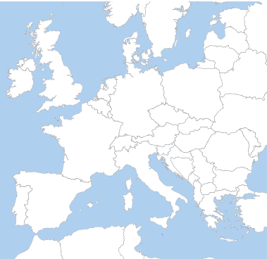
Feedstock supply
NORDZUCKER
Hanover
Project distribution
ZIELONA CHEMIA
Szczecin
Production
GREENCELL
Saint-Etienne-de-Chomeil
Formulation
LAMBERTI
Gallarate
Trials
INRA
Bordeaux
LCSA
CIAOTECH
Rome
TECNALIA
San Sebastian
EURION
Montpellier
Exploitation
Regulation
Technical product
Formulated product
Regulatory data
Notes:
We can observe how all the teams related to the project are among all Europe,

Slide 7
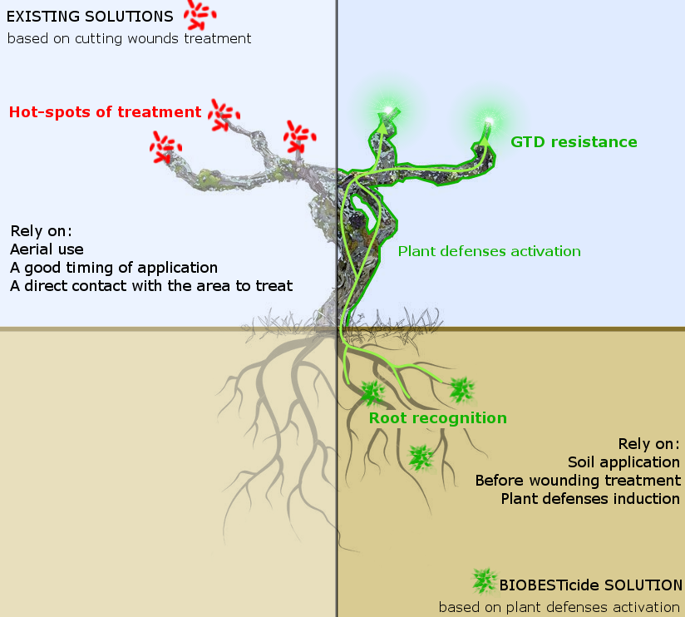
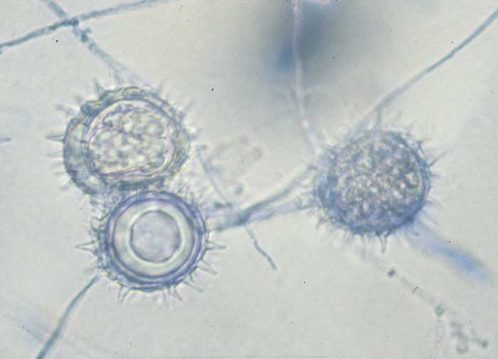
BioBESTicide mechanism
Pythium oligandrum
(oospores)
Daraignesa et al., 2018
Notes:
Different approaches has been used for the treatments of the GTDs
In the market there are mainly 2 options to treat this problematic, Synthetic chemical products, that has been not promoted by the EU sustainability framework
And Biocontrol agents (BCA) represented here for example as topic treatment that has to be applied directly in the would after desuckering the vine or grapes harvesting, this is time and resources consuming, and difficult for the management of the vineyards
The BioBESTicide solution represent a soil application, the use of the oospores of Pythium oligandrum $ prevents the development of the GTDs between 40 to 60%.
These oospores interact directly to the roots of the plan inducing the defence mechanisms of the plant against different pathogens via, mycoparasitism, competition of nutrients or elicitin-like proteins (oligandrin POD1 and 2)

Slide 8
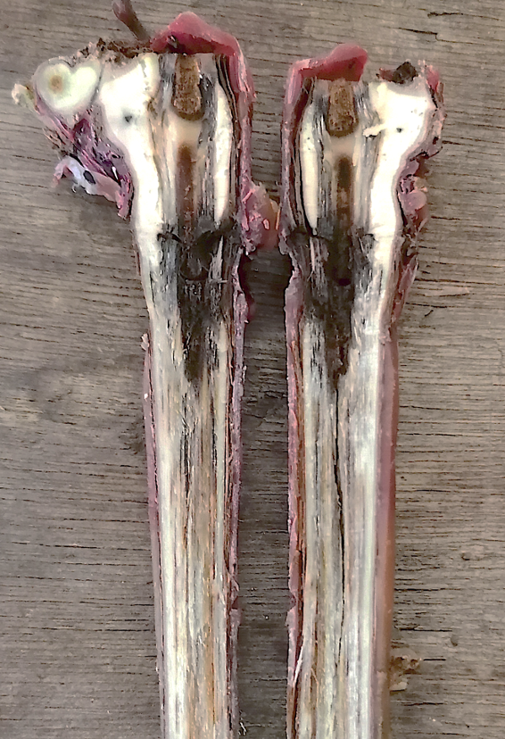
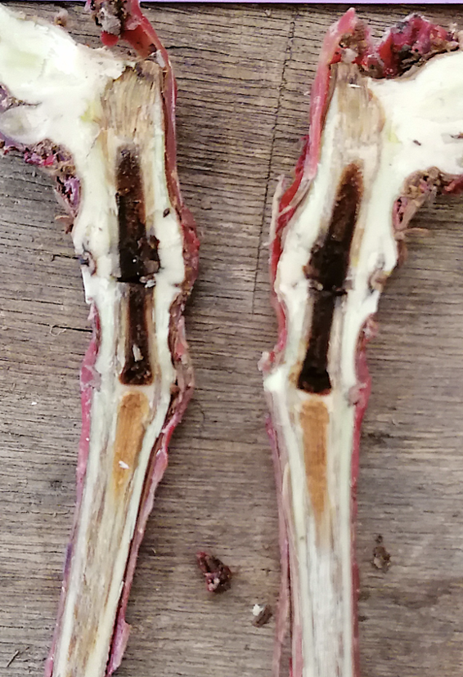
BioBESTicide results
Vine plant
+
Pathogen
+
Control
Vine plant
+
Pathogen
Pythium oligandrum
(oospores)

Slide 9
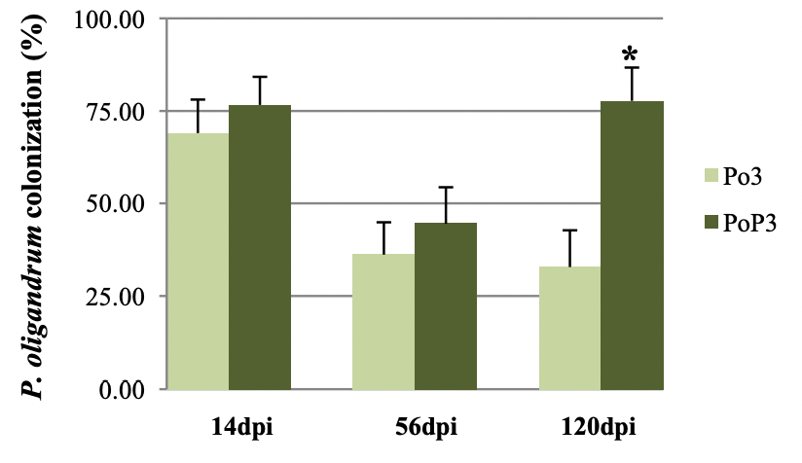
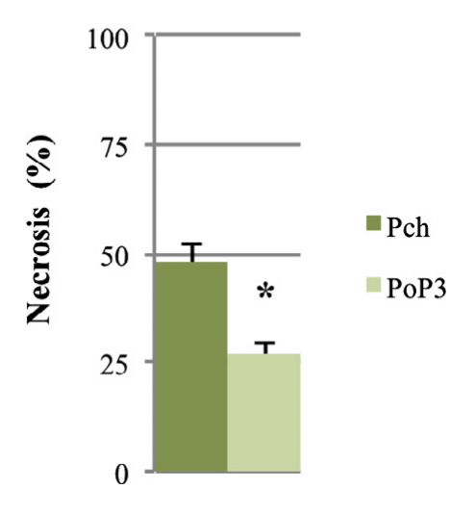
BioBESTicide results
Pythium oligandrum I-5180 root colonization and necrosis reduction in Vitis vinifera
BioBESTicide strain:
Increased root colonization (76%)
Reduction of root necrosis (48%)
Multi-pathogen protection (N. parum, P. chlamydospora)
Up to 2 years of proved protection
Gerbore et al., 2016
Gerbore et al., 2014
Berger et al., 2016
Yacoub et al., 2018
Notes:
The selection of the strain of Pythium oligandrum comes after sampling 44 strains of the oomycete frol the Bordeaux area
The best strain showed promising results reducing the necrosis by GTD in 48% and reaching a root colonization up to 76% of the plants after 120 days post infection

Slide 10
BioBESTicide results
Stem necrosis reduction up to 78 % in Vitis vinifera stems after 3 months post infection with Phaeomoniella chlamydospora
Lopez et al., 2022
Notes:
This graph shows the effect of Pythium oligandrum after infecting the vine with Phaeomoniella chlamydospore
The plan was pierced in the stem and a control with and without being infected was performed, then the plants inoculated with Pythium oligandrum oospores in 4 different formulations
And the effect of these 4 formulations without Pythium oligandrum
After we observe that among the 4 formulation the Liquid B can reduce up to 78% the stem necrosis

Slide 11
BioBESTicide current activities
5 treatment modalities
Solid + Po
Solid - Po
Liquid + MTD + Po
Liquid + MTD - Po
Non treated plants
2 inoculation modalities
Non drilled non inoculated (NPni)
Phaeomoniella chlamydospora (Pch)
5 harvest times
5 repetitions per modalities
P. chlamydospora
wood
Illumina
sequencing
P. oligandrum
rhizosphere
24 hours
1 week
2 weeks
8 weeks
14 weeks
Three-months follow-up
Time after P. oligandrum inoculation
Pathogen inoculation
250 plants
Results will be obtained in May 2023

Slide 12
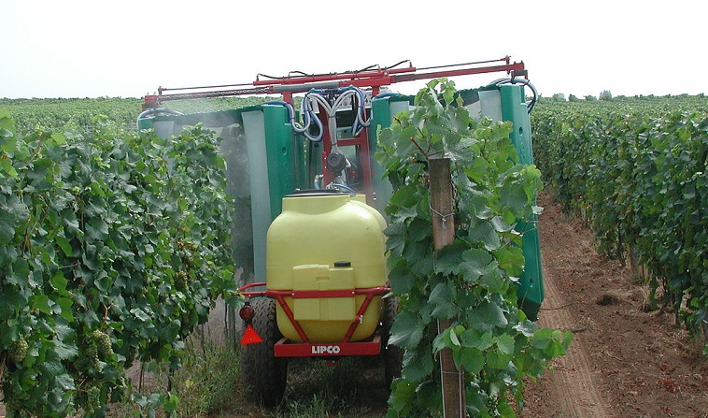
BioBESTicide application
Soil-direct application
Same equipment as pesticides
Non-hazardous components
Environmental friendly
Sustainable

Slide 13
BioBESTicide regulation
The final version of the approval dossier (DAR – Draft Assessment Report) is available and was sent to EFSA (Under public revision).
Completion of the approval dossier to add Pythium oligandrum strain I-5180 in the list of the approved active substances at European level
Submission of the dossier to the concerned European Ministries (France, Italy and Spain). Expected for 2023

Slide 14
Practical
Effective
Safe
Sustainable
Available in 2023

Slide 15
Contacts
Assia DREUX-ZIGHA
Project coordinator
assiadreux@greencell.tech
Enrique GONZALEZ
R&D engineer
enriquegonzalez@greencell.tech
Ahmed TAHIBI
R&D engineer
ahmedtahibi@greencell.tech
Thanks for your attention

